Slide 1
WEEK 7 By Michelle Klecker
Associative Arrays
Inheritance
Object Orientation
Objects
Stringify

Slide 2
Objects And Object Creation
OBJECT- a special type of data that has its own properties and methods
Objects are variables too, but they can contain many values
Example=var person = {firstName:"John", lastName:"Doe", age:50, eyeColor:"blue"};
To start making an object start with a constructor function (formally called creating an instance of an object)
Functions are also objects
The special keyword THIS tells the code you are working with the current object
You have to use the keyword new when making a new object

Slide 3
Associative Arrays
Associates a word with another variable instead of a number
Replace number with characters
Access it the same as any other array
Not going to see them as often as number arrays but its still good to know

Slide 4
Inheritance
To implement in Javascript, an object inherits from another object
Object inherits all the properties and methods of its parent object in order to become a specialized version of the parent object
Prototype property to establish subclass that retains its own properties and methods as well as that of the parent stuff
Use the prototype property to help child class inherit from parent class
Overrides the functionality of parent class

Slide 5
Stringify
The JSON.stringify() method converts a Javascript object to a JSON string
It includes three parameters including: value, replacer, and space
Useful if you wanted to pass the string onto another application
Syntax: JSON.stringify(value[, replacer[, space]]);
Value- The value to convert to a JSON string.
Replacer – A function that alters the behavior of the stringification process, or an array of string and numberobjects that serve as a whitelist for selecting/filtering the properties of the value object to be included in the JSON string. If this value is null or not provided, all the properties of the object are included in the resulting JSON string.

Slide 6
Stringify Continued . .
Space- A string or number object that’s used to insert white space into the output JSON string for readability purposes. If this is a Number, it indicates the number of space characters to use as white space; this number is capped at 10 if its larger than that. Values less than 1 indicate that no space should be used. If this is a String, the string (or the first 10 characters of the string, if its longer than that) is used as white space. If this parameter is not provided (or is null), no white space is used.

Slide 7
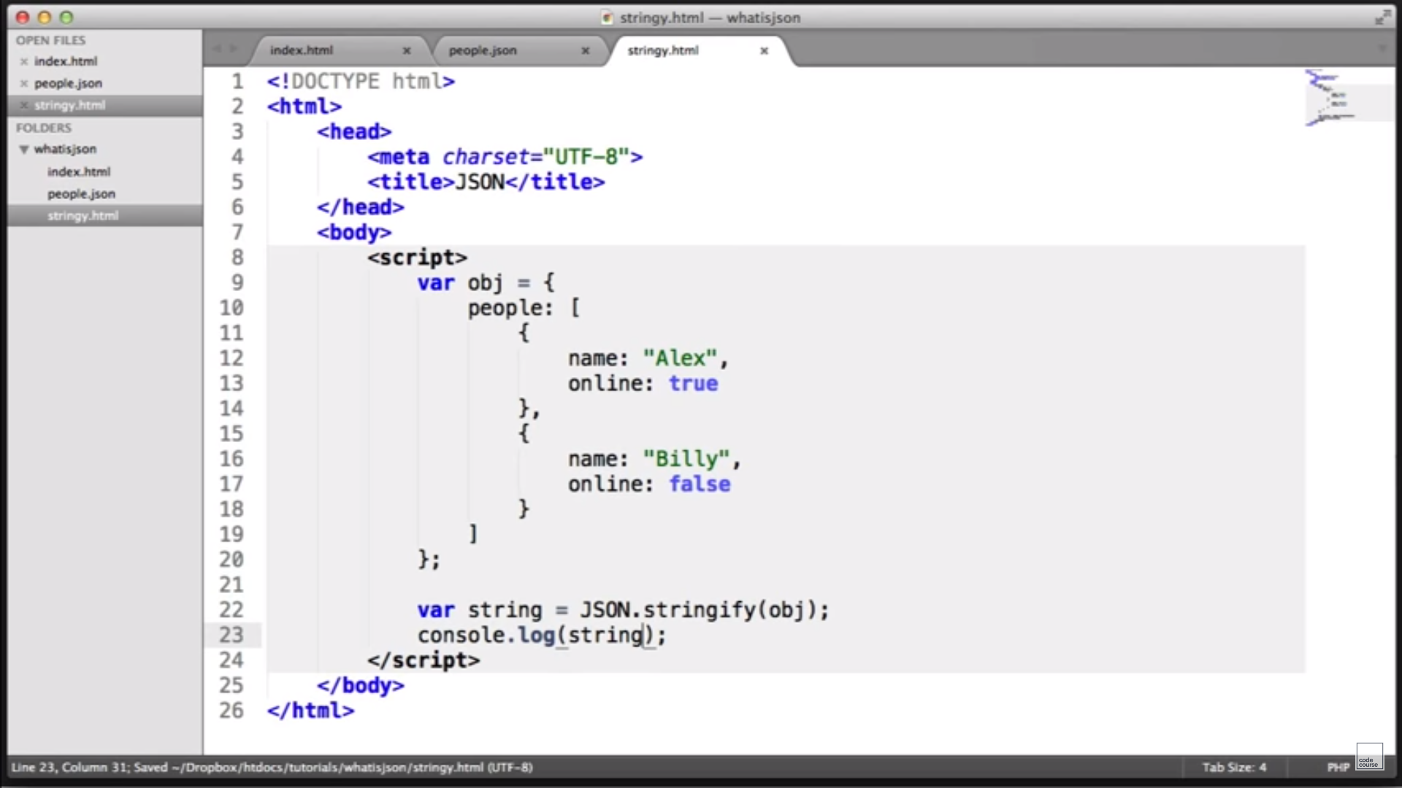
Stringify Example

